Slide 1
Ground rules
Sustainable
Our PPTs default mode is dark. Energy saved in every slide. Navigate through the bright cover slides and use the Knowit-black-background for everything else.
Accessible
Our columns are narrow and line lengths short for an easy, and accessible read
Keep it simple
Highlight only what strengthens your story. Leave everything else behind. And make every illustration count ☺

Slide 2
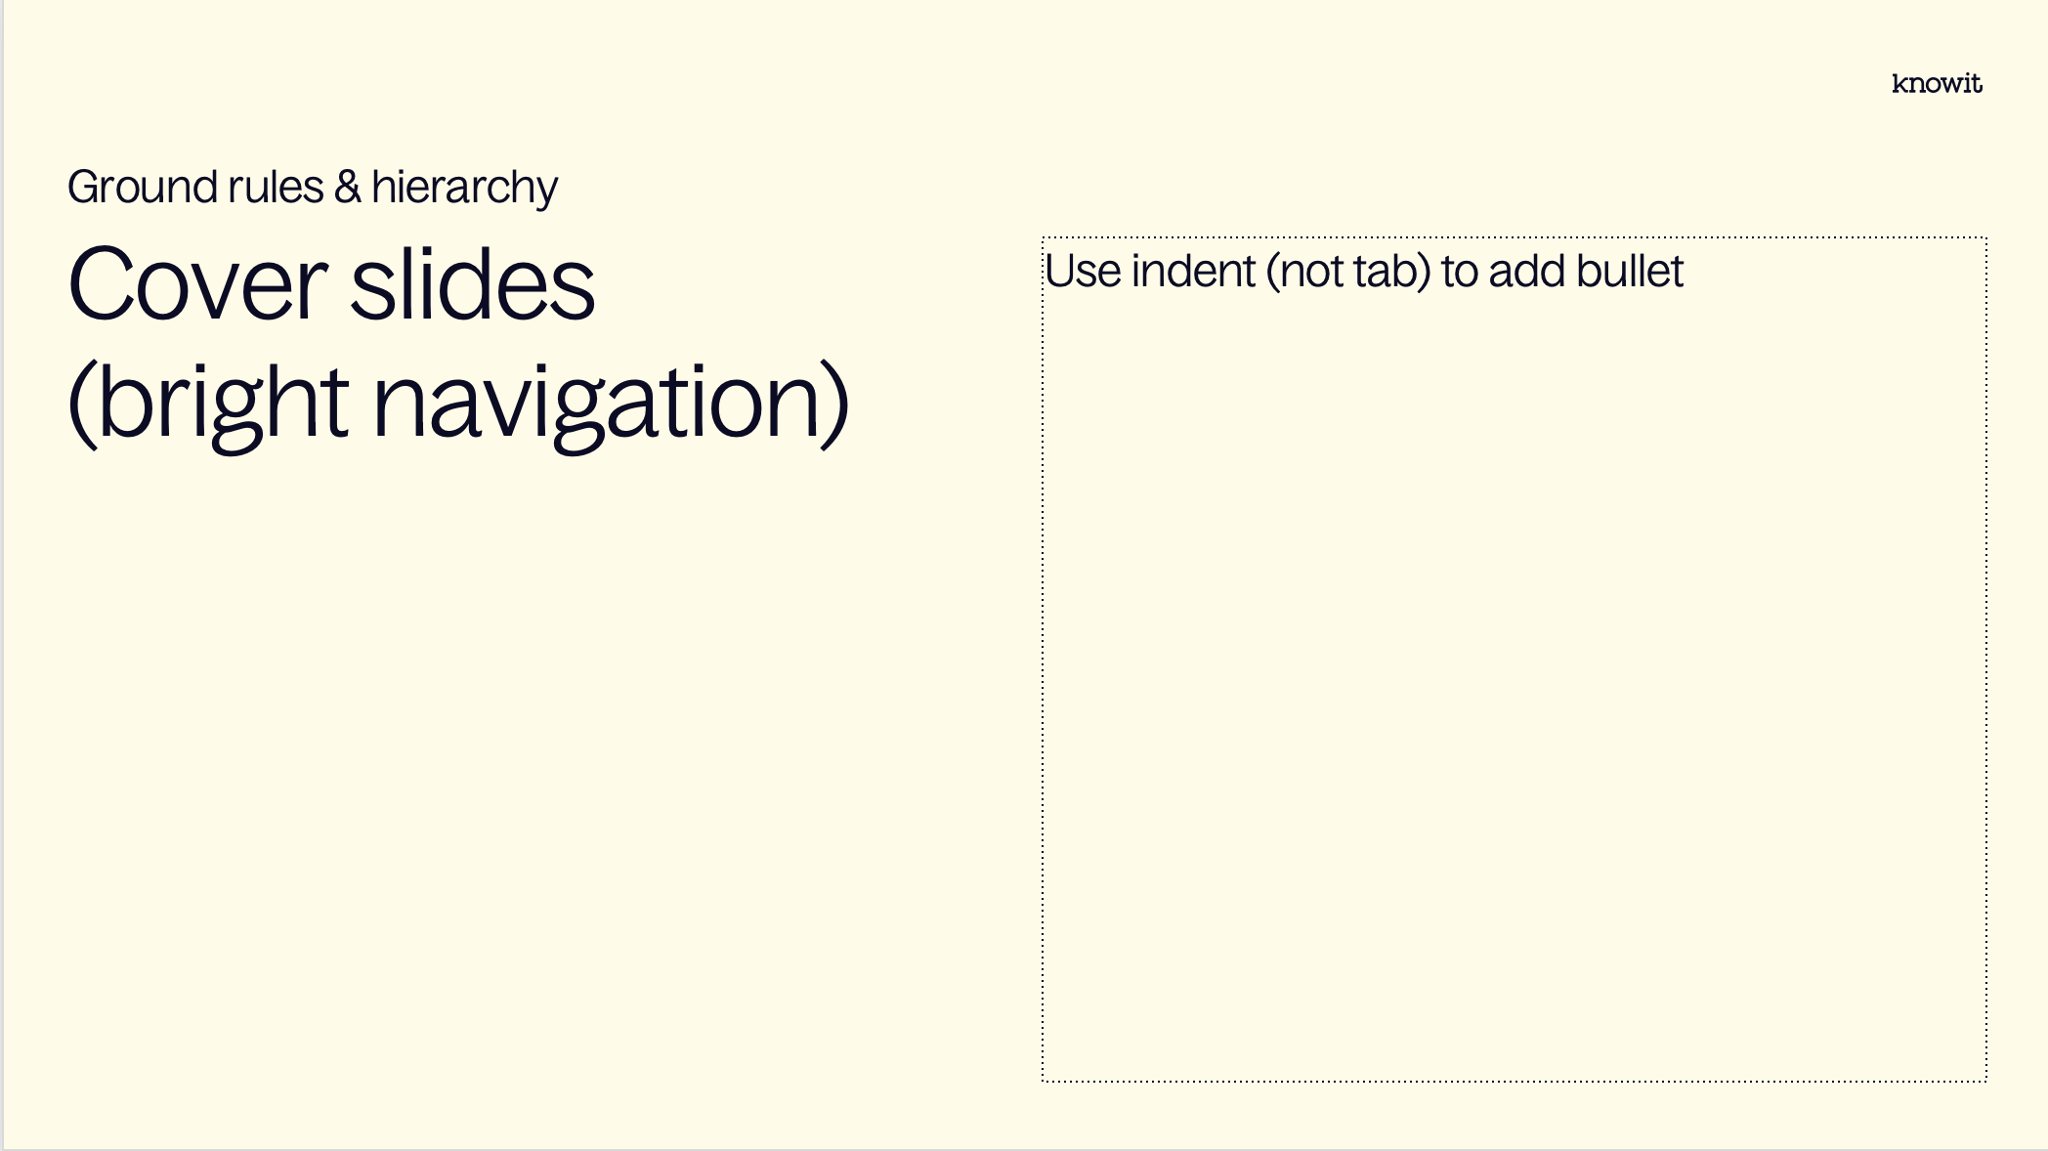
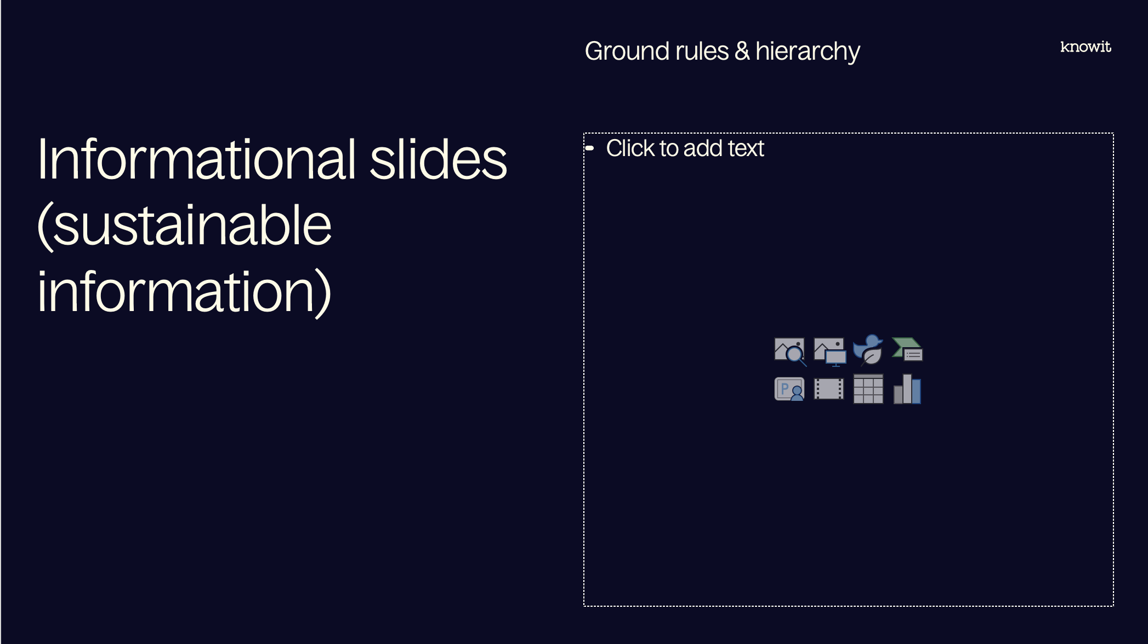
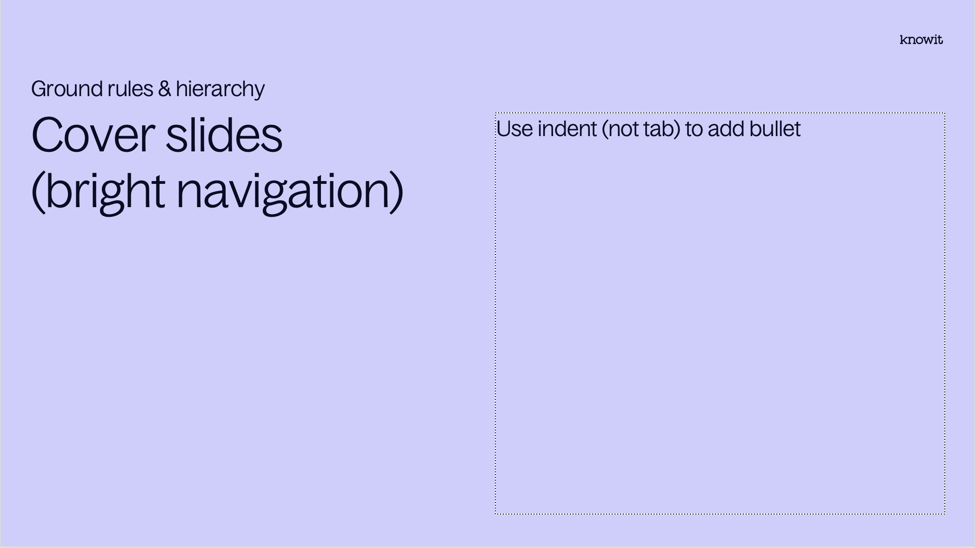
Visual prioritization

Slide 3
PowerPoint skills
Tips
Our template contains 38 different layouts, choose with care (and ask a colleague if you can’t find them)
The layout names might be helpful
Confused about colors or typographic rules? Check out the margins for some guidance
Have fun! (Break some rules if it helps you elevate your kick-ass-content☺)

Slide 5
Embedded academy Communication interfaces

Slide 6
Content
Introduction
SPI
UART
I2C
Jtag
Other topics

Slide 7
Lab
Introduction
In today’s lab we will implement a small uart interface to communicate with a PC-program

Slide 8
Notes from previous session

Slide 9
Reminder for today
Notes from last session
Stack
Flash

Slide 10
SPI

Slide 11
SPI
SPI
Serial peripheral interface
Used for short distance communication between integrated circuits
Master-slave configuration
Commonly used for flash, DAC, Eeprom etc.

Slide 12

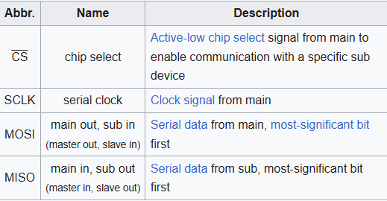
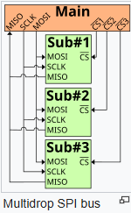
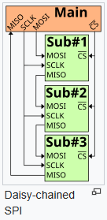
How it works
SPI
Every clock cycle, main and sub shifts out one bit and reads one bit.
After 8 cycles one byte is transmitted

Slide 13
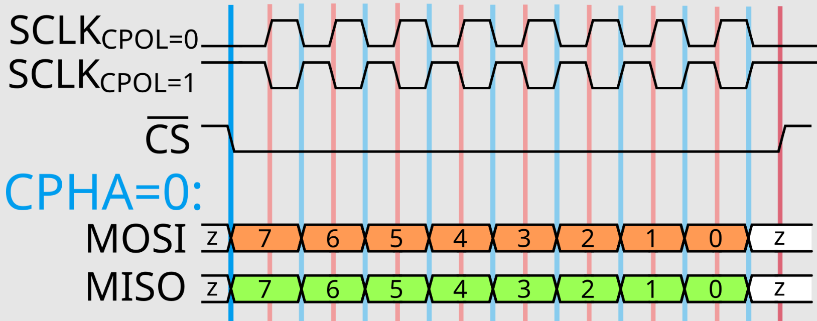
How it works
SPI

Slide 14

Pros and cons
SPI
Pros
Good signal integrity
High throughput
Full duplex (both can transmit and receive simultaneously)
Simple hardware
Low power
Cons
Only handles short distances
No formal protocol
No interrupts
No flow control
No acknowledgement
No error check

Slide 15
I2C

Slide 16
I2C
I2C
Inter-integrated circuit
Used for short distance communication between integrated circuits
Master-slave configuration
Commonly used for Eeprom, real-time clocks, simple LCDs
System Management Bus (SMBus) defines stricter substandard
Typically 100 kbit/s

Slide 17
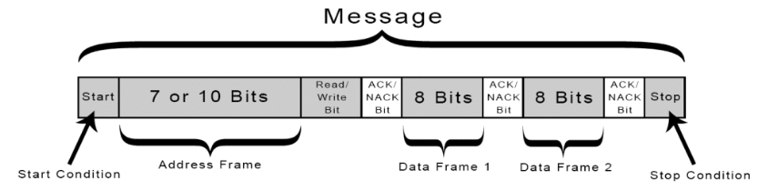
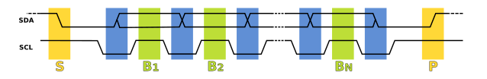
How it works
I2C
Starts by pulling SDA low while SCL is high
Sends address to node to communicate with
Send data 8 bits at a time until stop
Ack on every byte

Slide 18
Pros and cons
I2C
Pros
Cheap
Require only two pins to control a full network
Semi duplex
Addressing
Acknowledgements
Cons
Slow
Address conflicts
Requires more space on PCB

Slide 19
UART

Slide 20
UART
UART
Universal Asynchronous Reciever-Transmitter
USART also exist which support synchronous communication
Used for serial communication
Also known as RS232

Slide 21
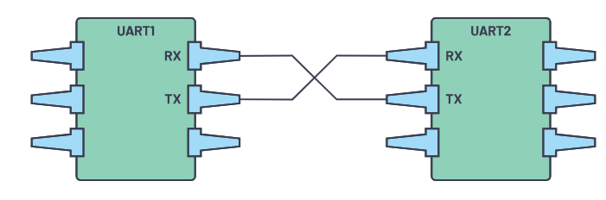
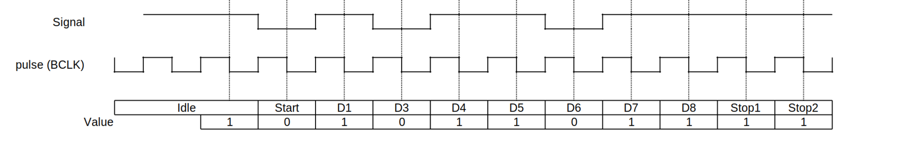
How it works
UART
Requires same configuration on both ends for:
Voltage (can be solved with level switch)
Baudrate
Parity bit
Data bits size
Stop bits size
Flow control

Slide 22
Pros and cons
Uart
Pros
Simple
No clock signal requirement
Error detection
Supports longer distances
Cons
Only allows two devices on bus
Low speed

Slide 23
Jtag

Slide 24
JTAG
JTAG
Joint Test Action Group
Industry standard for verifying electronics
Used for debugging embedded systems
Dedicated debug port
Direct access to system addresses and data buses
Test Access Port (TAP) is a key element
Serial Wire Debug (SWD) is a two pin alternative, defined for ARM architecture

Slide 25
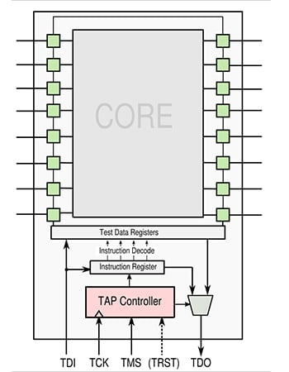
How it works
JTAG
TDI (Test Data Input) — test data input. The commands and data are inserted into the chip through this pin on the rising edge of the signal TCK.
TDO (Test Data Output) — serial data output. Commands and data are output from the chip through this pin on the falling edge of the signal TCK.
TCK (Test Clock) — clock input.
TMS (Test Mode Select) — controls the transitions between states of the finite state machine TAP.
TRST (Test Reset) — reset signal of the TAP finite state machine.

Slide 26
Other protocols

Slide 27
Other protocols
Other protocols
Controller Area Network (CAN)
Modbus
Ethernet/IP
EtherCAT

Slide 28
Other topics related to the course?

Slide 29
DMA Clarification
I2C
Direct Memory access allows a peripheral device to write straight to memory
DMA request from peripheral
DMA Controller provides bus access to memory
DMA Controller sends interrupt to processor when data transfer is done

Slide 30
Questions?

Slide 31
Lab part

Slide 32












































































Our icons

Slide 33

















UN SDG (PNG)

Slide 34

















UN SDG (SVG)

